Slide 1
EXAMROOM
Presented By:
Karan Chaurasia
Suraj Mishra
Sani Chaturvedi
Abhishek yadav
Kinjal Varshney

Slide 2
OUTLINE
About the Project
Objective
Requirements
Snapshots from the website

Slide 3
ABOUT THE PROJECT
In the recent years, we have realized the importance of virtual learning and how important it is for us to have our resources online. Conducting exam online makes it easy for both the student and organization.
In the century we are living the world is progressing at a really great pace, a lot number of technologies come up every single day. To keep up with the technology is also important to survive in this world of digitalization and learning. Along with this we need to have a place to keep the resources for areas of our interest so we thought of developing a portal which could provide us with exam conduction as well as a platform where we could keep the we like marked. Adding to its features, some of the Quizes will pop up into the suggestion box according to the recent search, making you go deep into the field you are learning in.
Moreover this kind of application can be used in areas/schools where guardians /parents cannot afford to buy Quizes. This would be an excellent effort to provide education without any boundaries to all.

Slide 4
OBJECTIVE
The purpose of on-line test simulator is to take online test in an efficient manner and no time wasting for checking the paper. The main objective of on-line test simulator is to efficiently evaluate the candidate thoroughly through a fully automated system that not only saves lot of time but also gives fast results.
For students they give papers according to their convenience and time and there is no need of using extra thing like paper, pen etc.

Slide 5
REQUIREMENTS
Software Specification Used:-
Technology Implemented:
Front End: HTML & CSS ,Typescript & Angular 9
Back End: Spring Boot
IDE Used: Visual Studio Code & InteliJ
Web Browser: Google Chrome

Slide 6
Hardware Used:
Processor Used: Ryzen 5
Operating System: Windows 11
RAM: 8 GB
Hardware Devices: Computer System
Hard Disk: 512 GB

Slide 7
THIS IS HOW OUR WEBSITE LOOKS
Hope you will like it :)

Slide 8
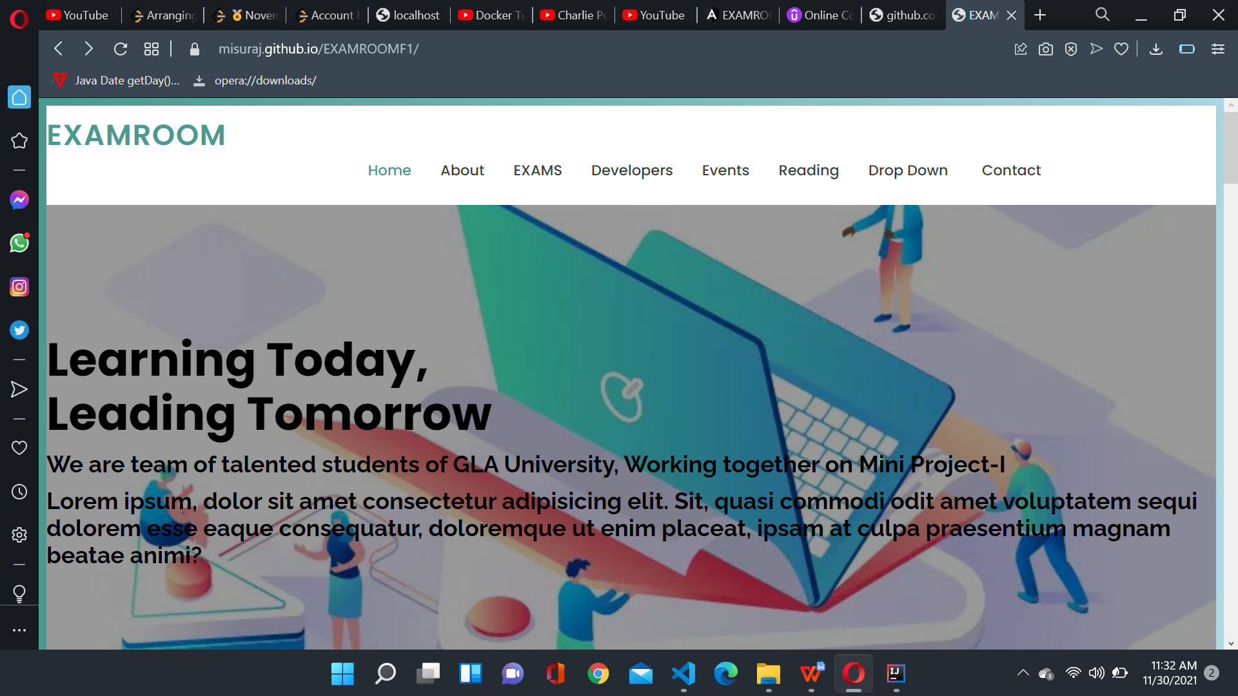
FRONT PAGE

Slide 9
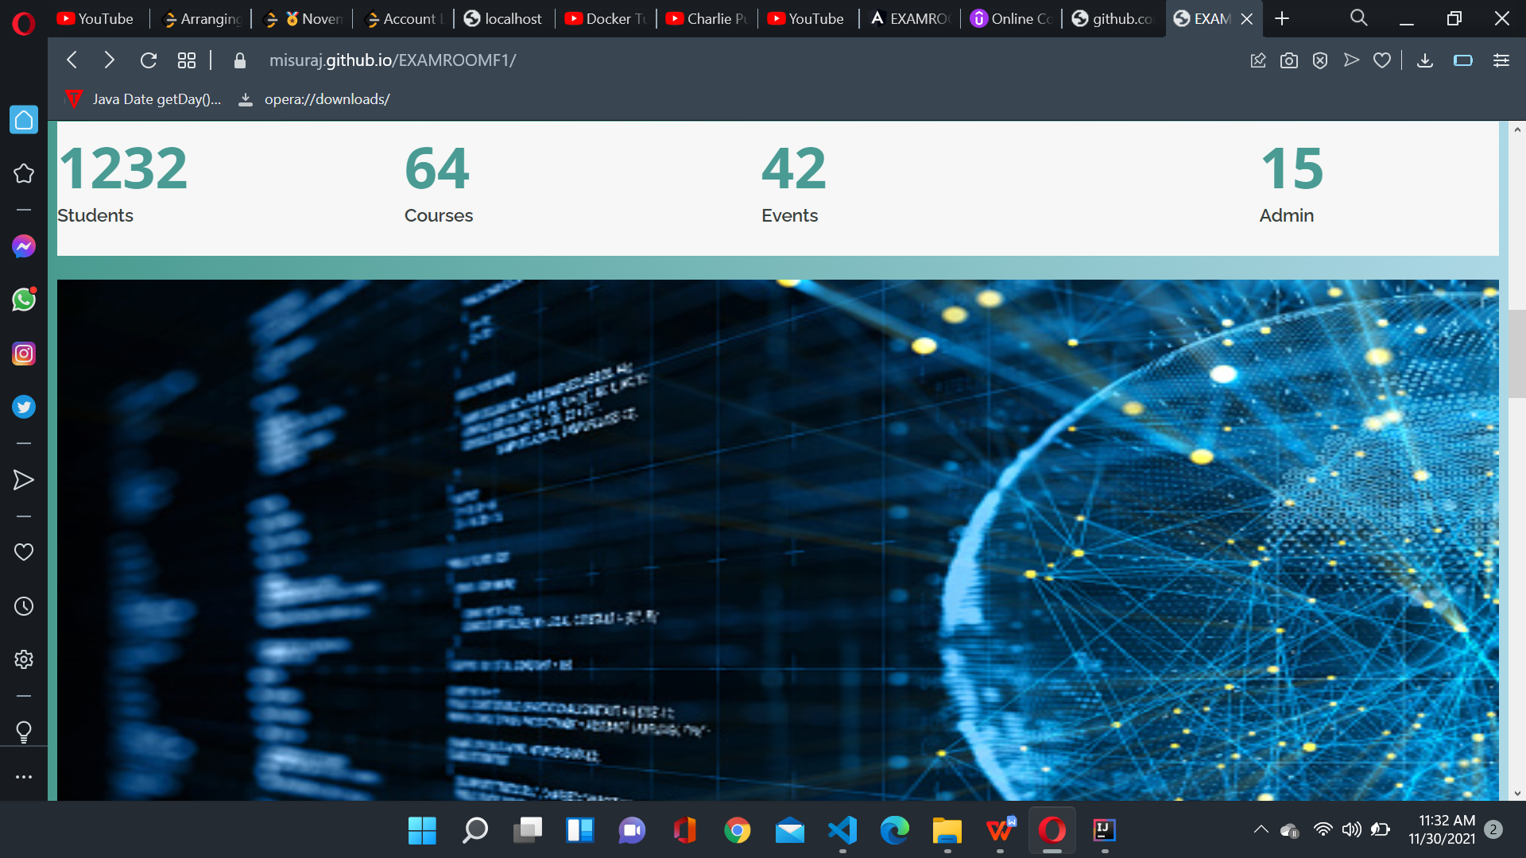

Slide 10
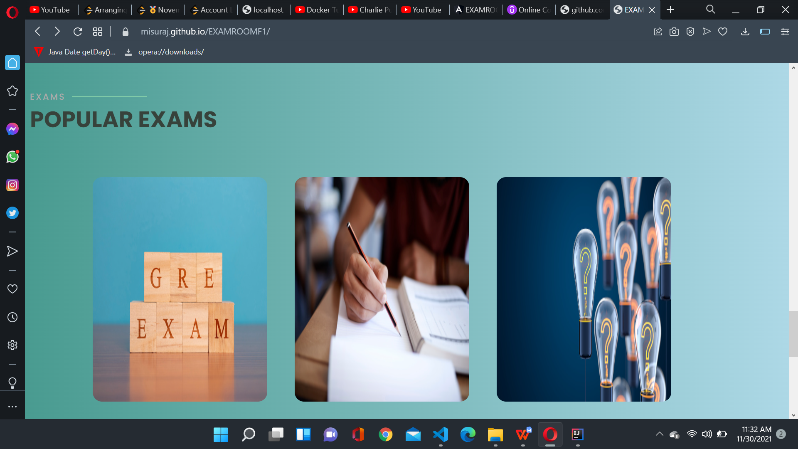

Slide 11
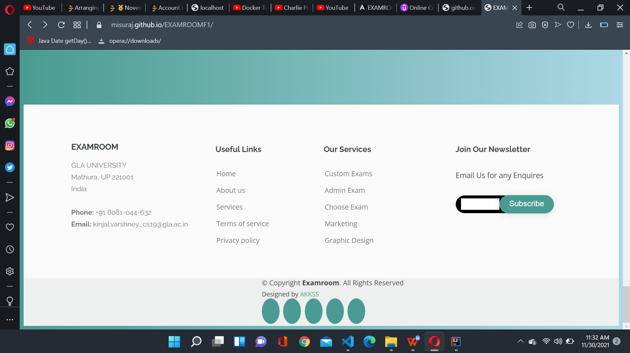

Slide 12
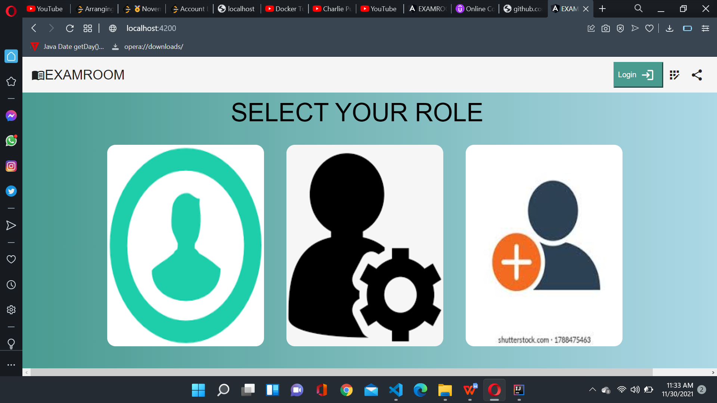
2.LOGIN & SIGNUP PAGE

Slide 13
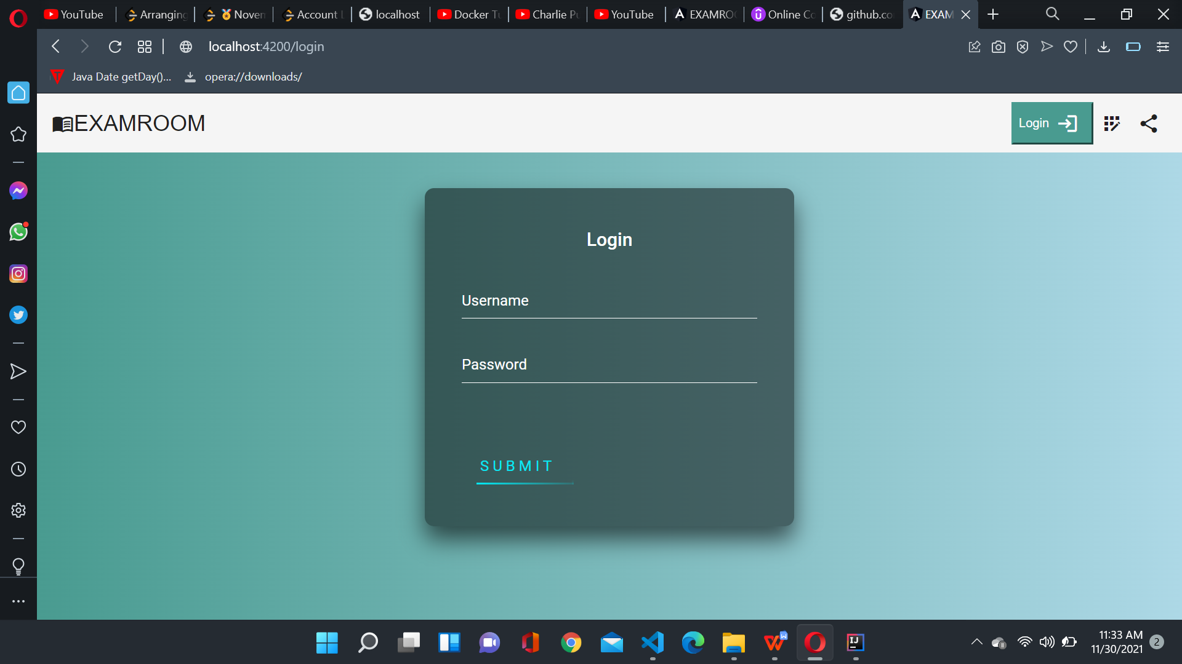

Slide 14
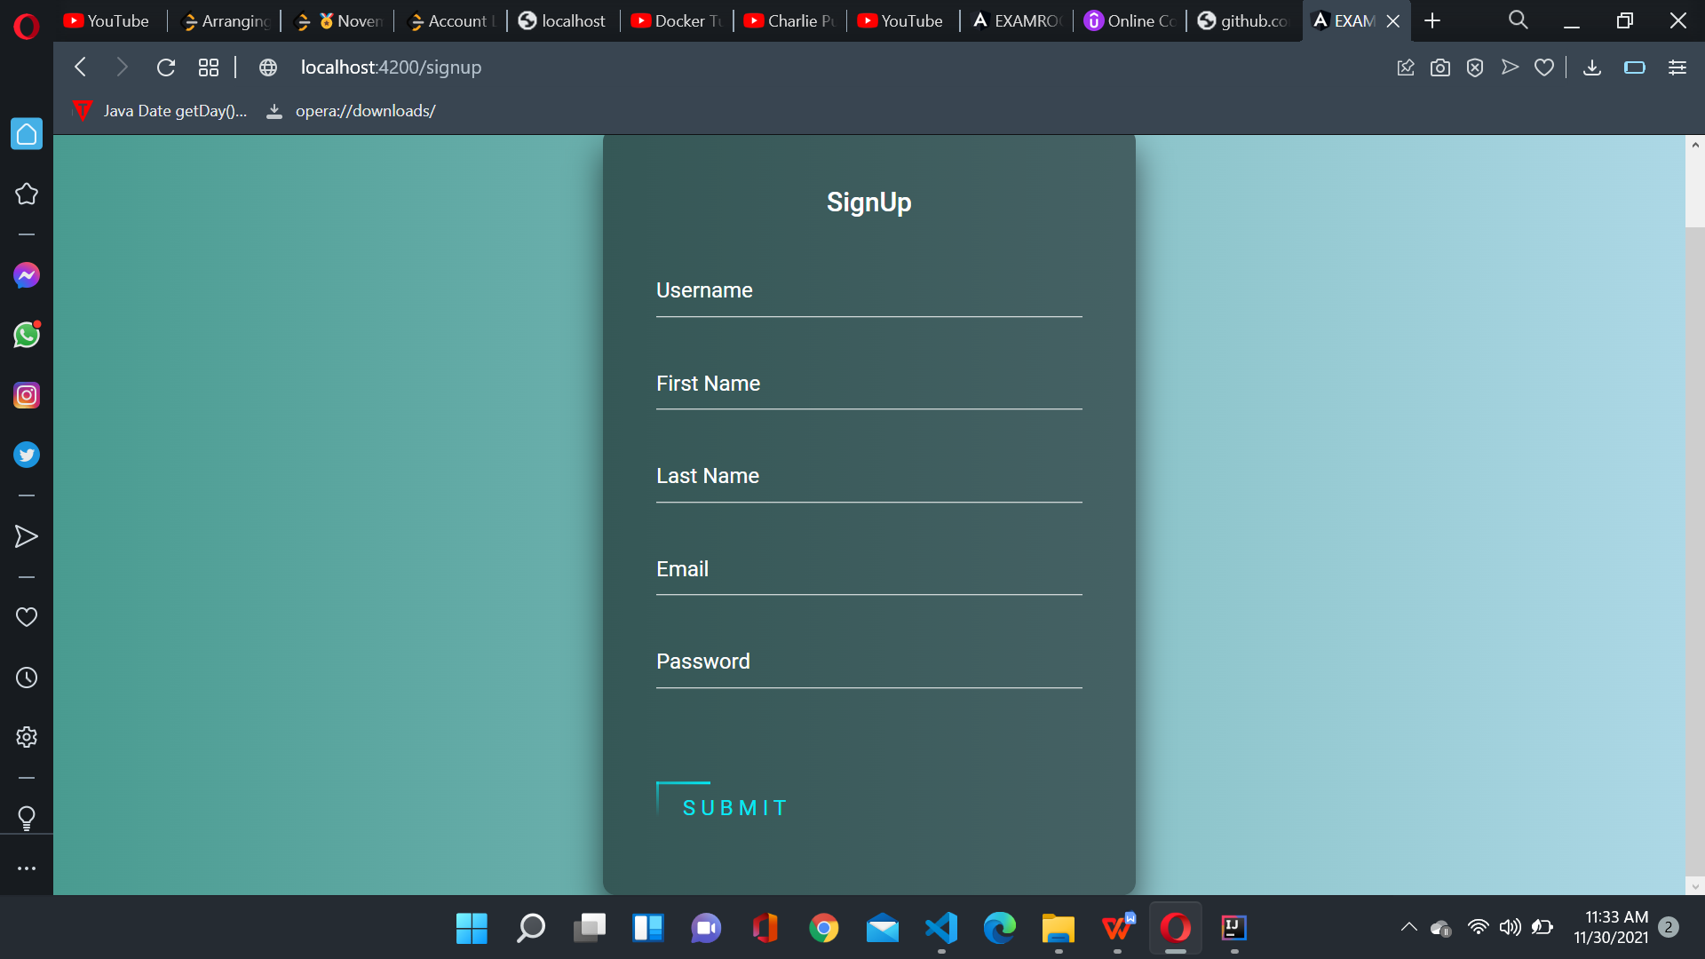

Slide 15
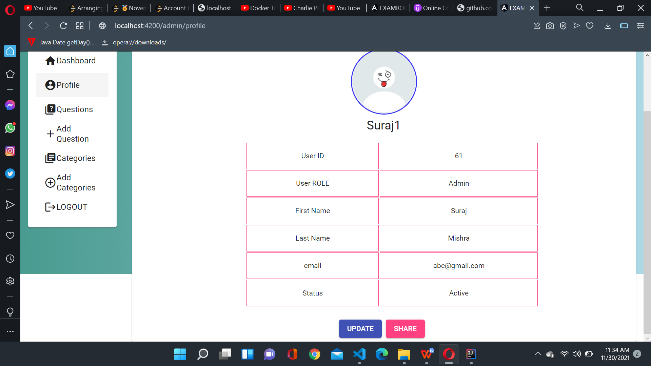
3. ADMIN DASHBOARD

Slide 16
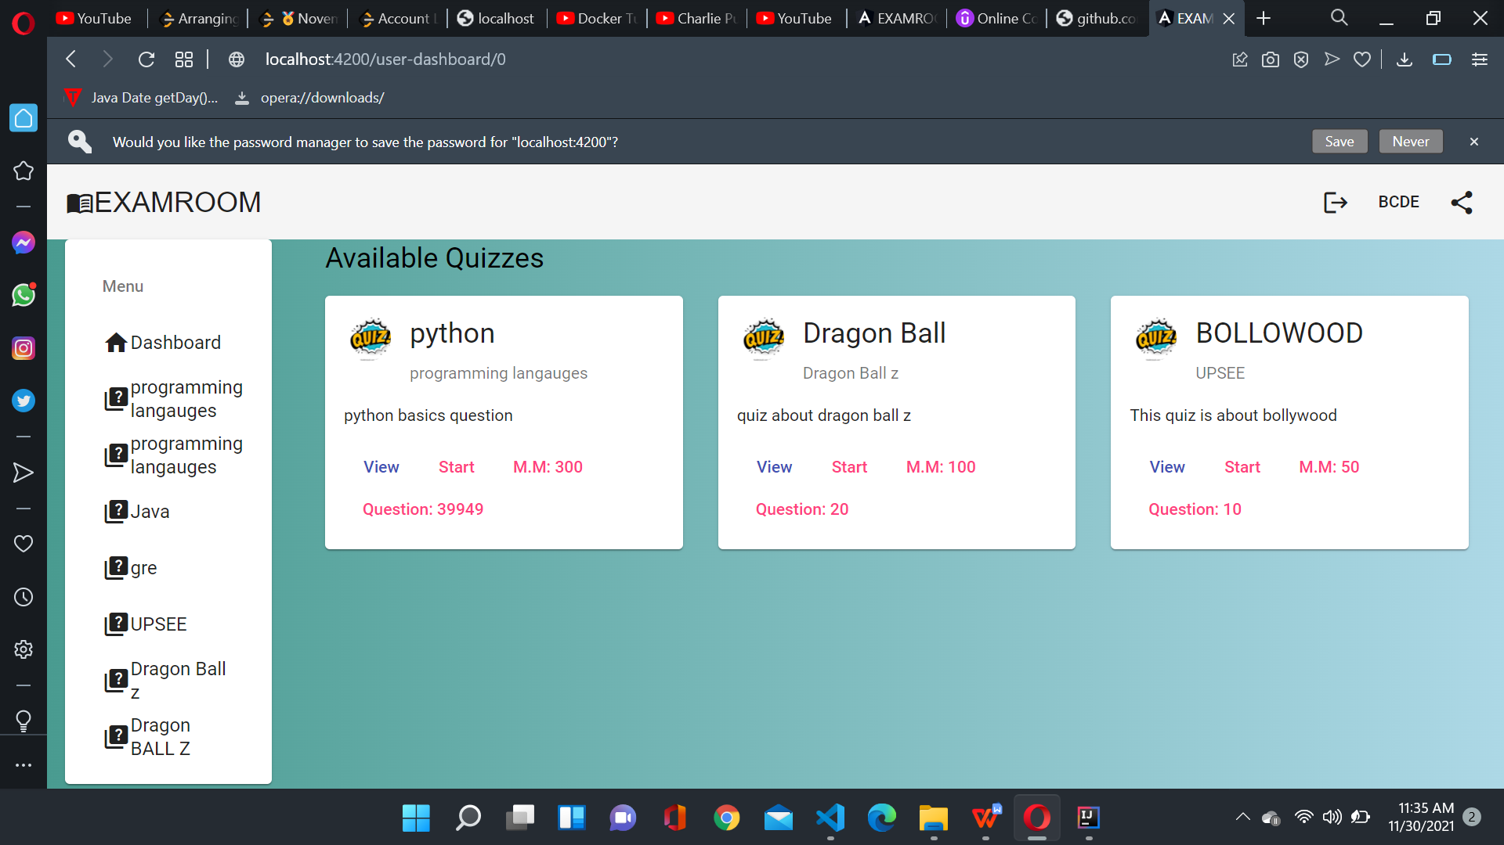
4. USER DASHBOARD

Slide 17
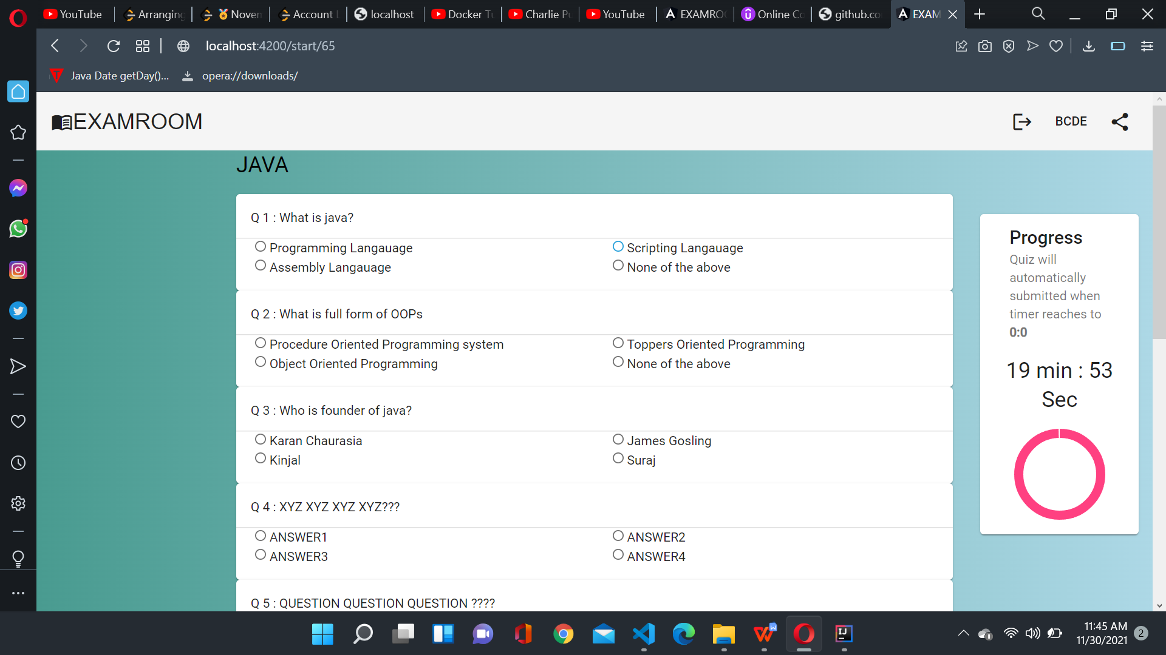
5. QUIZE PAGE

Slide 18
Conclusion
The On line test System is developed using Java and sql fully meets the objectives of the system for which it has been developed. The system has reached a steady state where all bugs have been eliminated. The system is operated at a high level of efficiency and all the teachers and user associated with the system understands its advantage. The system solves the problem. It was intended to solve as requirement specification.

Slide 19
Thank You!!!

